Slide 1

Design and Analysis of Algorithms
Dinesh Singh
Department of Computer Science & Engineering

Slide 2
DESIGN AND ANALYSIS OF ALGORITHMS
2-3 Trees
Dinesh Singh
Department of Computer Science & Engineering

Slide 3
Design and Analysis of Algorithms
2-3 Trees
2-3 Trees
Balanced trees, ensure efficient operations.
Operations: Search, Insert, Delete
Performance depends on tree height
Balanced trees maintain height ϴ(log n)

Slide 4
Design and Analysis of Algorithms
2-3 Trees
Definition of 2–3 Trees
A 2–3 tree is a balanced search tree.
Internal nodes can be:
• 2-node (1 key, 2 children)
• 3-node (2 keys, 3 children)
All leaves appear at the same level

Slide 5
Design and Analysis of Algorithms
2-3 Trees
2-node Structure
Contains one key K
Two children
Left subtree: keys < K
Right subtree: keys > K
Similar to a binary search tree node

Slide 6
Design and Analysis of Algorithms
2-3 Trees
3-node Structure
Contains two keys K1 and K2 ( K1 < K2)
Three children
Left sub tree: keys < K1
Middle sub tree: K1 < keys < K2
Right sub tree: keys > K2

Slide 7
Design and Analysis of Algorithms
2-3 Trees
Key Property
All leaves appear at the same level
Every root-to-leaf path has equal length
Ensures the tree remains balanced
Height is ϴ(log n)

Slide 8
Design and Analysis of Algorithms
2-3 Trees
Searching in 2–3 Trees
Start at the root
If node is a 2-node:
  Compare key and move left or right accordingly or stop if key is found
If node is a 3-node:
  Use at most two comparisons to decide if key is found or
which of the root’s three sub trees searching needs to be continued.

Slide 9
Design and Analysis of Algorithms
2-3 Trees
Insertion
Insert new key in a leaf
Find appropriate leaf position
If leaf has 1 key → becomes 3-node
If leaf has 2 keys → overflow occurs
Handling Overflow
When a node temporarily has 3 keys:
Sort the keys
Promote the middle key to parent
Split node into two nodes

Slide 10
Design and Analysis of Algorithms
2-3 Trees
Cascading Splits
If parent already has two keys
Promotion causes another split
Splits may propagate up to the root
A new root may be created

Slide 11
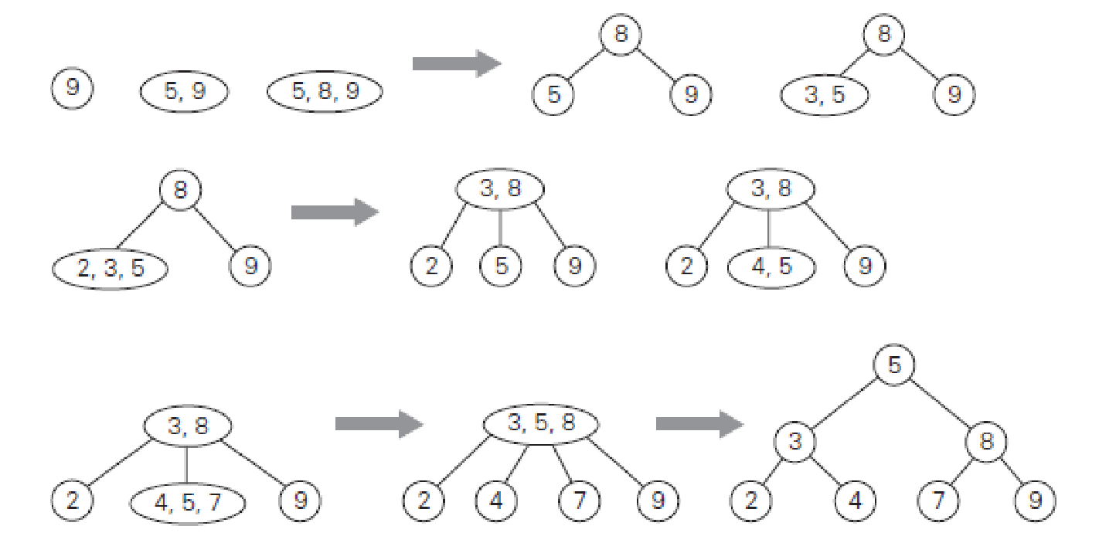
Design and Analysis of Algorithms
2-3 Trees
Construction of a 2-3 tree for the list 9, 5, 8, 3, 2, 4, 7.

Slide 12
Design and Analysis of Algorithms
2-3 Trees
Height Upper Bound
When tree contains only 2-nodes:
  n ≥ 1 + 2 + 2² + ... + 2^{h}
  n ≥ 2^{(h+1)} − 1
  Therefore h ≤ log₂(n+1) − 1
Height Lower Bound
When tree contains only 3-nodes:
  n ≤ 2(1 + 3 + 3² + ... + 3^{h})
  n ≤ 3^{(h+1)} − 1
  Therefore h ≥ log₃(n+1) − 1

Slide 13
Design and Analysis of Algorithms
2-3 Trees
Height Range
log₃(n+1) − 1 ≤ h ≤ log₂(n+1) − 1
Thus tree height is ϴ(log n)
Time Complexity
Search:ϴ(log n)
Insertion: ϴ(log n)
Deletion: ϴ(log n)
Balanced height guarantees efficiency

Slide 14
Design and Analysis of Algorithms
2-3 Trees
Summary
2–3 Trees are balanced search trees
Nodes contain 1 or 2 keys
All leaves at same depth
Operations run in logarithmic time
Foundation for B-Trees

Slide 15
Design and Analysis of Algorithms
Multiple choice Questions
In a 2–3 tree, suppose the tree has height h and contains only 2-nodes. Which of the following expressions gives the minimum possible number of keys n in the tree?
n=2^{h−1}
n=2^{h+1}−1
n=3^{h−1}
n=3^{h+1}−1
Answer B : n=2^{h+1}−1

Slide 16
Design and Analysis of Algorithms
Multiple choice Questions
A 2–3 tree contains 364 keys. What is the maximum possible height of the tree?
A. 5
B. 6
C. 7
D. 8
Answer A : 7

Slide 17
Design and Analysis of Algorithms
Multiple choice Questions
During insertion in a 2–3 tree, a leaf node already contains two keys K1​ and K2​. After inserting a new key K, which of the following operations must occur first?
A. The largest key is promoted to the parent
B. The smallest key is promoted to the parent
C. The middle key is promoted to the parent
D. The node becomes a 4-node permanently
Answer C: The middle key is promoted to the parent

Slide 18
Design and Analysis of Algorithms
Multiple choice Questions
In a 2–3 tree search, what is the maximum number of key comparisons performed at a single node?
A. 1
B. 2
C. 3
D. Depends on the height of the tree
Answer B: 2

Slide 19
THANK YOU
Dinesh Singh
Department of Computer Science & Engineering

